Slide 1
MEN’S WEAR

Slide 2
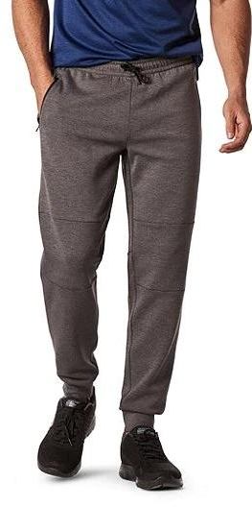
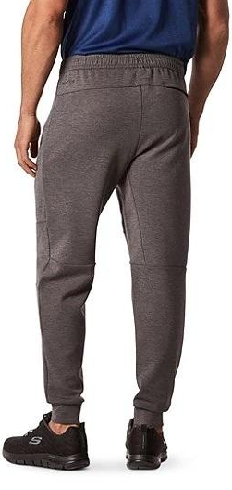
Men's Performance Double Knit Jogger
81% Polyester, 14% Rayon And 5% Spandex
Matrix Performance Stretch
Elasticated Waistband
Side Front Pockets. Single Back Welt Pocket

Slide 3
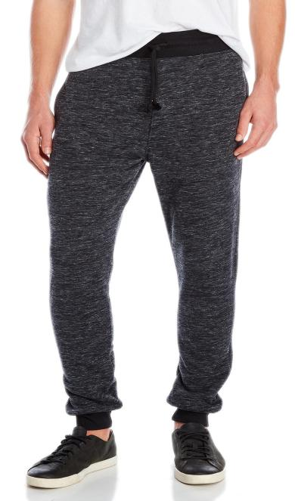
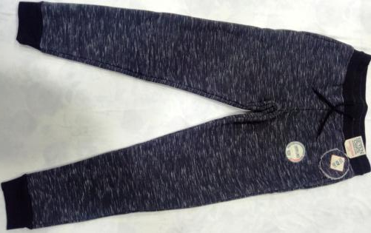
Men's Bonded Sherpa Jogger
Top Part Of Fabric - 60% Cotton 40% Polyester,
Cvc Jersey
Bottom Part Of Fabric 100% Polyester Sherpa
2x2 Rib Waistband & Cuff

Slide 4
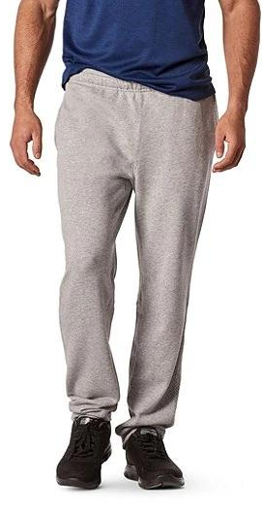
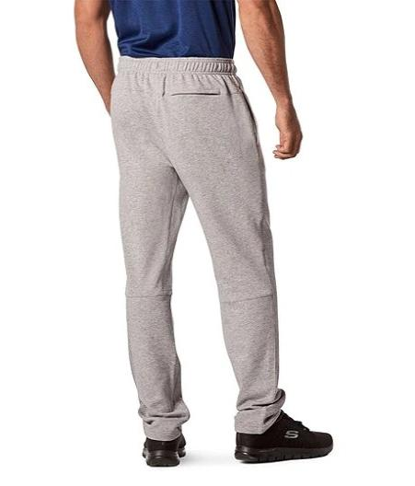
Men's Core Terry Pant
60% Cotton And 40% Polyester Terry
Pull-0n Elastic Waist
Side Pockets. Single Back Welt Pocket

Slide 5
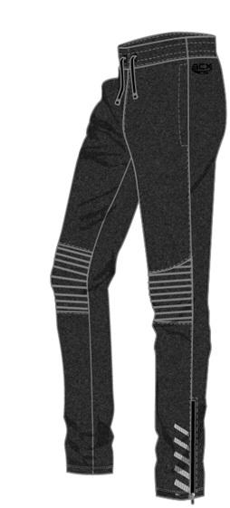
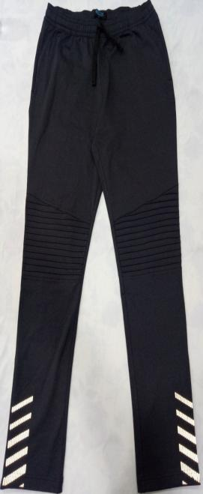
Men’s Knit Pin tuck Pant
92% Polyester 8% Spandex
Jersey With Brushed Back
External Functional Drawstring At Waist
Pre-shrunk Elastic On Waist
Reflective Screen Print Bottom Both Legs.
Zipper At Btm Leg Opening With Rubber Tip

Slide 6
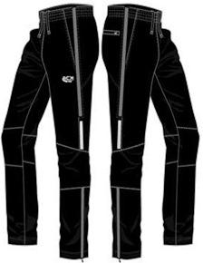
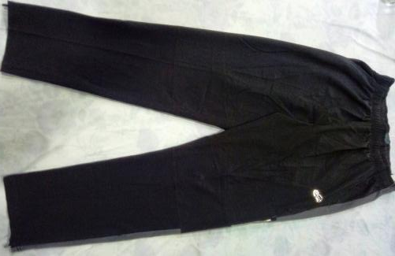
Stretch Taslon Pant
88% Polyester 12% Spandex,
Taslon
Elastic At Waist
Inner Drawstring
Side Pocket
Back Pocket Zipper
Side Leg Zippers

Slide 7
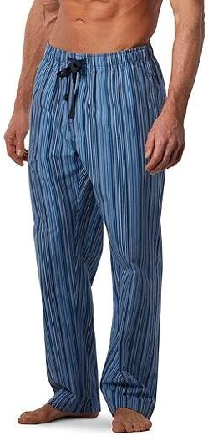
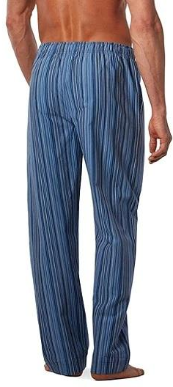
Men's Woven Stripe Lounge Pants
100% Cotton
Elastic Waistband With Drawstring
Reinforced Functional Fly
2 On-seam Pockets With Bartacks
2-needle Topstitch On Hem And Back Seam

Slide 8
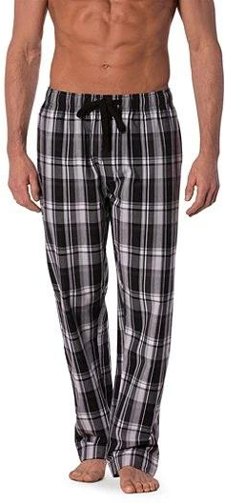
Men's Plaid Pajama Pants
100% Cotton
Peached Finish
2-needle Top Stitch On Hem And Back Seam
2 Seam Pockets With Bartacks
J-stitch Functional Reinforced Fly

Slide 9
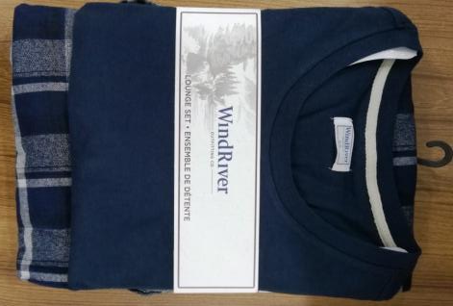
T-Shirt and Pant Pajama Set
T-shirt: 95% Cotton And 5% Viscose
Crew Neck
Short/Long Sleeves
Pant: 100% Cotton
Elastic Waistband With Drawcord, Side Pockets

Slide 10
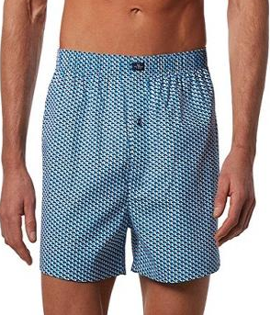
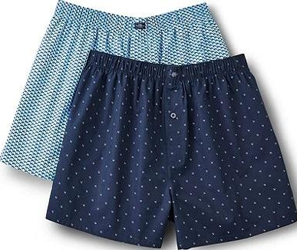
Men's 2-Pack Status Woven Boxer Briefs
100% Cotton
Elasticized Comfort Waist
Comfort Fit Seat
Reinforced Buttoned Fly
Double-stitched Seams
2-pack

Slide 11
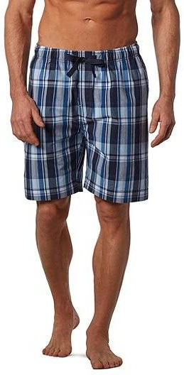
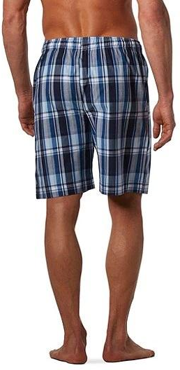
Men's Woven Plaid Lounge Shorts
100% Cotton
Elastic Waistband With Drawstring
Reinforced Functional Fly
2 On-seam Pockets With Bartacks
2-needle Topstitch On Hem And Back Seam

Slide 12
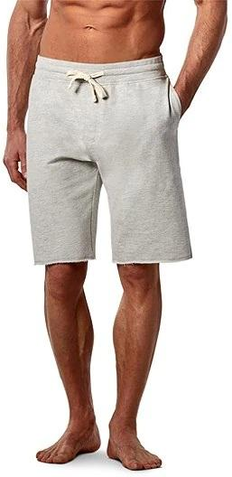
Men's French Terry Shorts
100% Cotton
Elastic Waist With Drawstring
Non-functional Fly
Side Seam Pockets. Single Back Welt Pocket
Raw Edge Leg Opening

Slide 13
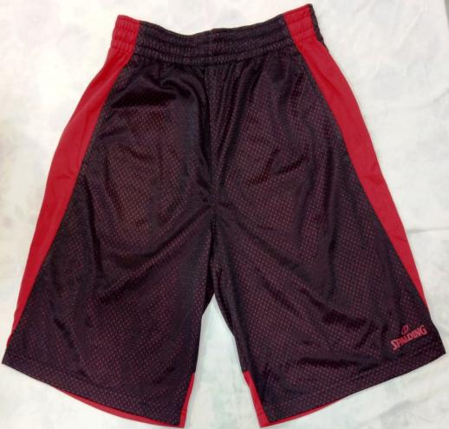
Classic Shorts
100% Polyester Large Hole Mesh Fabric
Side Pockets
Elastic Waist With Inner Drawstring

Slide 14
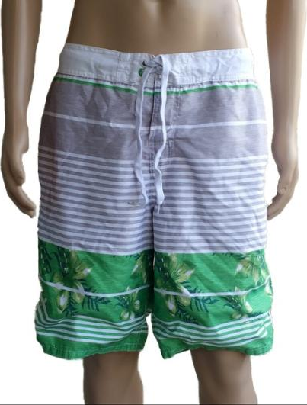
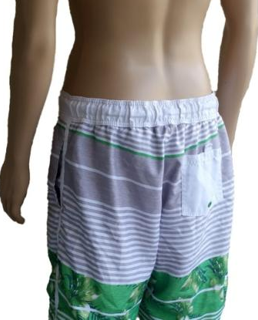
OP Ocean Pacific Mens Swim Shorts
100% Polyester Shell/lining
Drawstring waist w/hook & latch closure
2 Front pockets
1 Back pocket with hook/latch closure lined

Slide 15
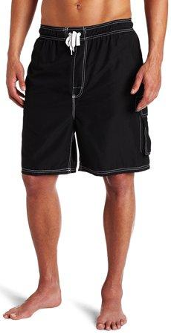
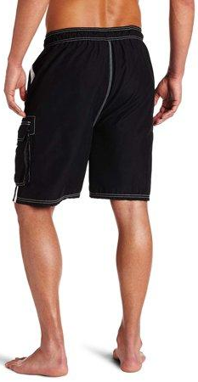
Kanu Surf Swimwear
100% Polyester
Board Shorts
White Men’s Small Board
Shorts Swimwear

Slide 16
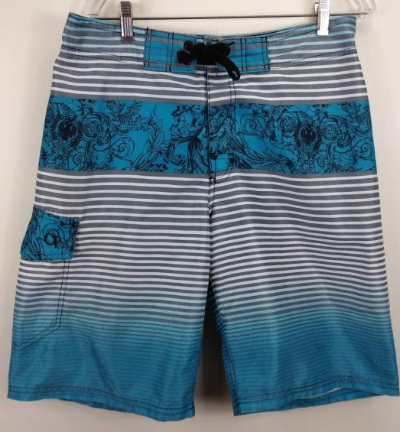
Board Shorts Swimming Trunks Floral
100% Polyester
Trunks Floral
Ocean Pacific Striped
Regular

Slide 17
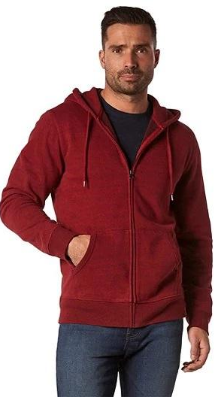
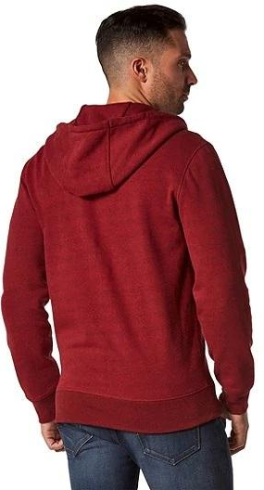
Men's Double Knit Full Zip Hoodie
81% Polyester, 14% Rayon
& 5% Spandex
Double-knit Construction
Hood With Drawcord
Side-entry Pockets
Long Cuffed Sleeves
Full Front Zippered Closure

Slide 18
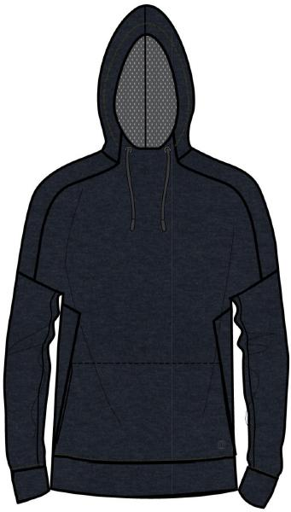
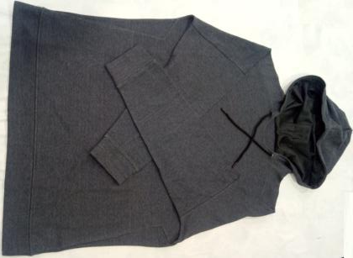
Justin Hoodie
52% Cotton 48% Polyester,
Cvc Interlock
Mesh Lining Hood
Hood With Drawcord
Side-entry Pockets
Cuffed Sleeves And Bottom Hem

Slide 19
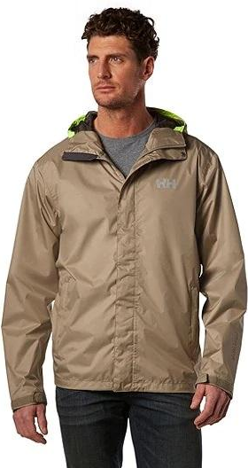
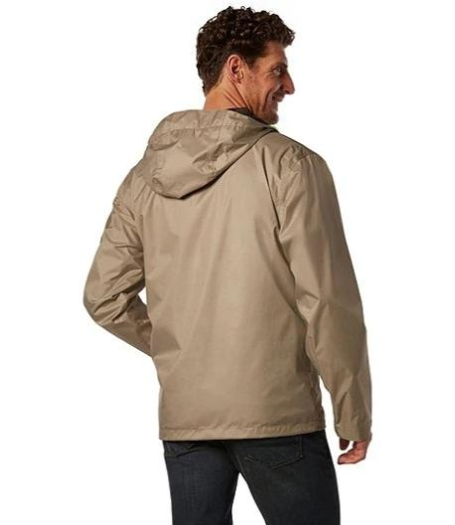
Men's 77 Jacket
100% Polyester Helly Tech
Waterproof. Breathable.
2-ply Fabric With Durable Water Repellency reatment
Zippered Hand Pockets
Lined For Comfort
Adjustable Cuffs, Hem And Hood

Slide 20
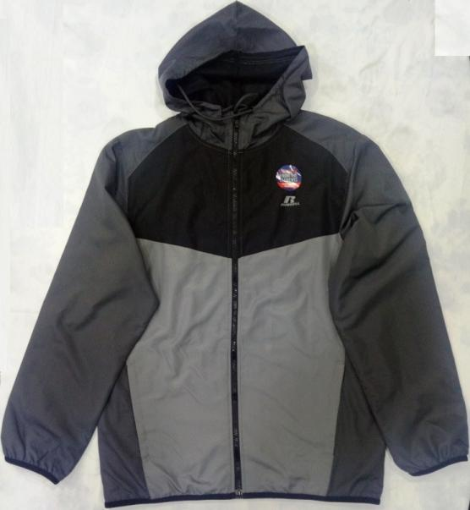
Men’s Woven Full Zip Jacket
100% Polyester Pu Coating
Elastic Binding On Cuff & Hem
Fake Down Insulation
Full Zip
Side Pockets

Slide 21
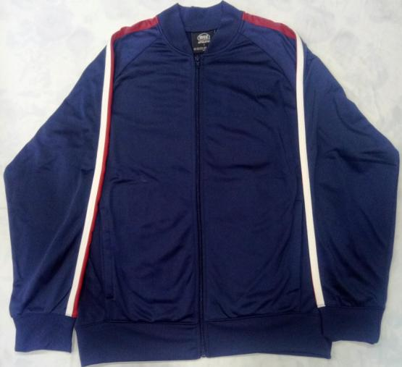
Track Jacket
100% Polyester, Brush Tricot
Full Zip
Cuffed Sleeves And Bottom Hem

Slide 22
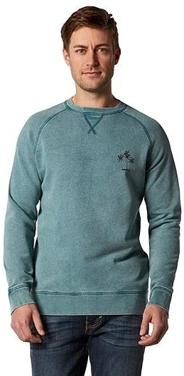
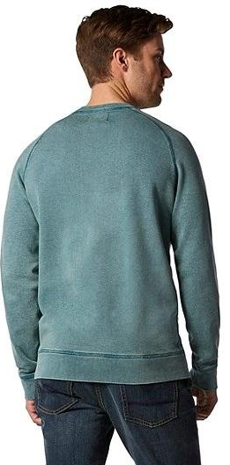
Men's Fleece Crew
100% Cotton
Garment Dyed
Crew Neck With V-stitching Detail
Chest Graphic
Long Raglan Sleeves

Slide 23
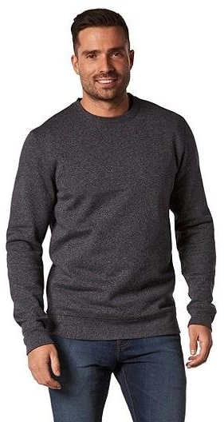
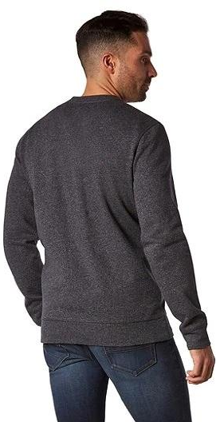
Men's Everyday Crew Neck Sweatshirt
67% Cotton And 33% Polyester
Crew Neck
Long Sleeves

Slide 24
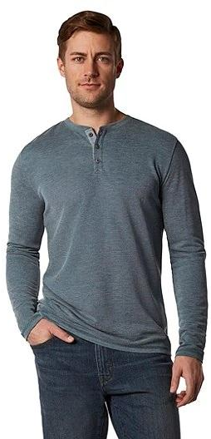
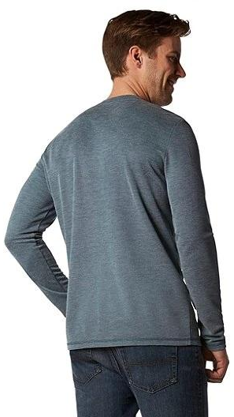
Men's Long Sleeve Melange Modal Henley Top
65% Modal And 35% Polyester
Soft Drape Comfort Fabric
Trim Across The Shoulders, Body And Sleeves
Henley Neck With 3-button Placket
Long Sleeves

Slide 25
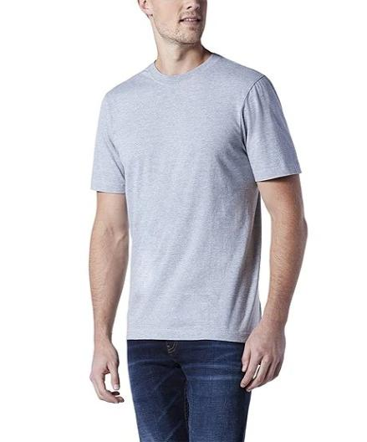
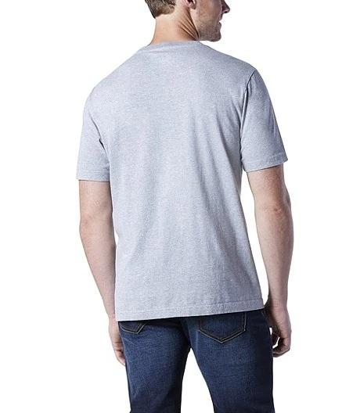
Men's Crew Neck T-Shirt
100% Cotton
Shrink-resistant
Crew Neck
Short Sleeves

Slide 26
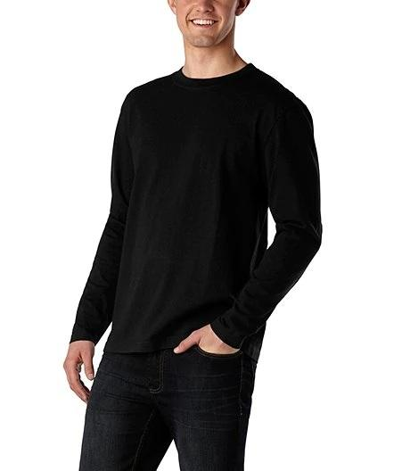
Men's Long Sleeve Crew Neck T-shirt
100% Cotton
Crew Neck
Long Sleeves

Slide 27
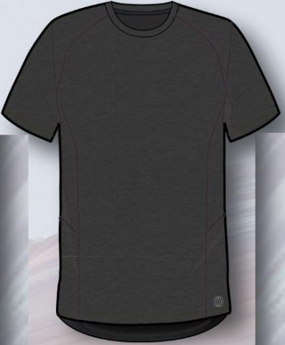
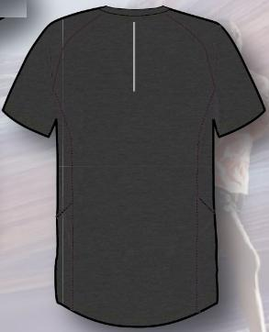
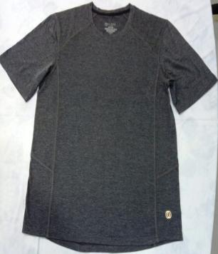
Garage Tee
87% Polyester 10% Rayon 3% Spandex,
Cross Dye, Wicking
No Side Seam

Slide 28
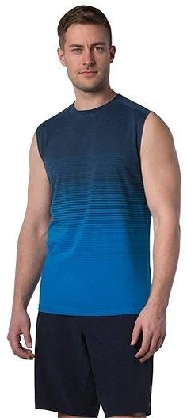
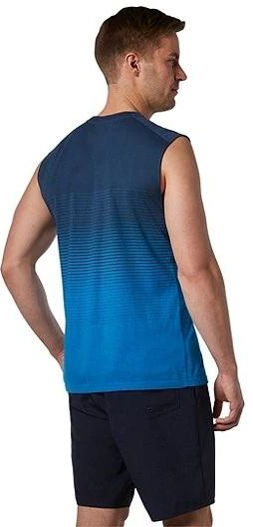
Men's Stripe Muscle Tank Top
50% Cotton And 50% Polyester
Muscle Tank Styling
Crew Neck

Slide 29
Men's Basic Tank Top
100% Cotton
Trim Across The Shoulders, Body And Sleeves
Tank Styling

Slide 30
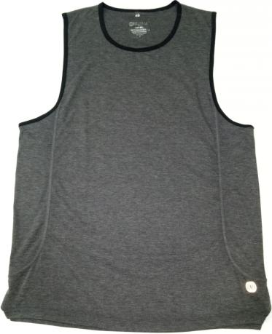
Frank Tank
87% Polyester, 10% Rayon And 3% Spandex
Cross Dye, Wicking

